Slide 1

Deep Reinforcement Learning for Robotic Grasping in an Unstructured Environment
Matthias Pouleau
Technische Universität München
TUM School of Computation, Information and Technology
Munich, February 3rd, 2025

Slide 2
Contents
Motivation
Problem Formulation and Training Environment
System Architecture and Baseline Implementation
Experiments and Results
Conclusion and Outlook

Slide 3
Motivation

Slide 4
Motivation
Object grasping is key manipulation task in robotics
Grasping fully known objects mastered since several years
Handling unknown or partially known objects more complex
Progress from Reinforcement Learning (RL) methods in recent years
Able to operate in environments with partial knowledge
Capacity to handle new, previously unseen scenarios
Key challenge is extracting valuable features from sensory input
Notes:
Applications across many fields:
manufacturing / logistics / agriculture / healthcare / …

Slide 5
Problem Formulation and Training Environment

Slide 6
Problem Formulation
Based on implementation of paper ‘Learning to Grasp on the Moon from 3D Octree Observations with Deep Reinforcement Learning’ by Andrej Orsula [1]
Grasping & lifting unknown objects with varying position, size, shape, and texture
Vision-based grasping task: RGB-D image as sensory input
Problem modeled as Markov Decision Process (MDP)
Agent learns end-to-end policy to perform high-level Cartesian actions
Translation: in x, y, and z direction within [-0.1, 0.1] boundary
Rotation: around z-axis within [-45°, 45°] boundary
Gripper control: opening or closing gripper
Notes:
MDP:
episodic environment
current state only depends on the last previous state

Slide 7
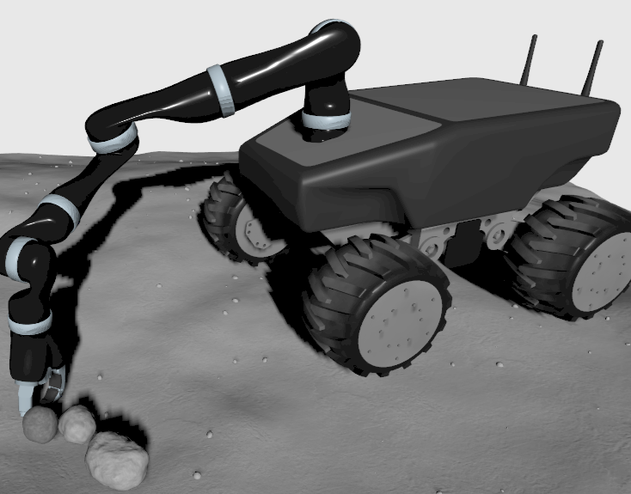
Training Environment
Lunar landscape simulated in IGN Gazebo
Robot: Summit XL-GEN from Robotnik
High-level policy step: 400 ms
Low-level simulation step: 5 ms
Low-level actions:
Joint positions
Path planning with RRT-Connect [2]
IK solving with TRAC-IK [3]
View of the mobile robot in the simulated lunar environment
Notes:
Robot: with 7-DOF Kinova Gen2 robotic arm & 3-finger gripper attached

Slide 8
System Architecture and Baseline Implementation

Slide 9
System Architecture - Observation Space and Feature Extraction
Frame stacking: observation consists of last two frames to capture motion
Proprioceptive observations: position, orientation, and state of gripper
Visual Observations:
RGB-D image transformed into 3D point cloud
3D Octree constructed from point cloud (depending on use case)
Visual feature extraction via encoder network:
O-CNN for octree observations
PointNet-based or 3D-Diffusion-Policy-based for point-cloud observations

Slide 10
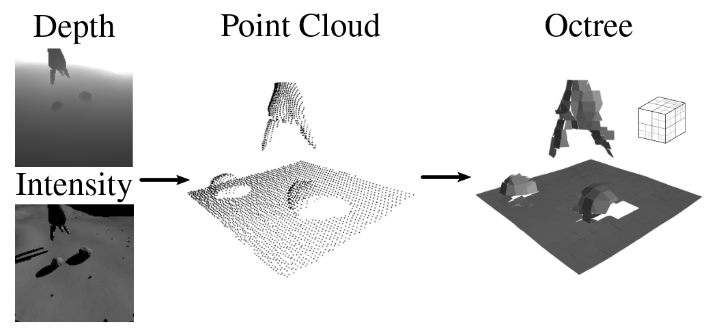
System Architecture - Observation Space and Feature Extraction
Visual representation of the conversion of the RGB-D input into an Octree, from [1]

Slide 11
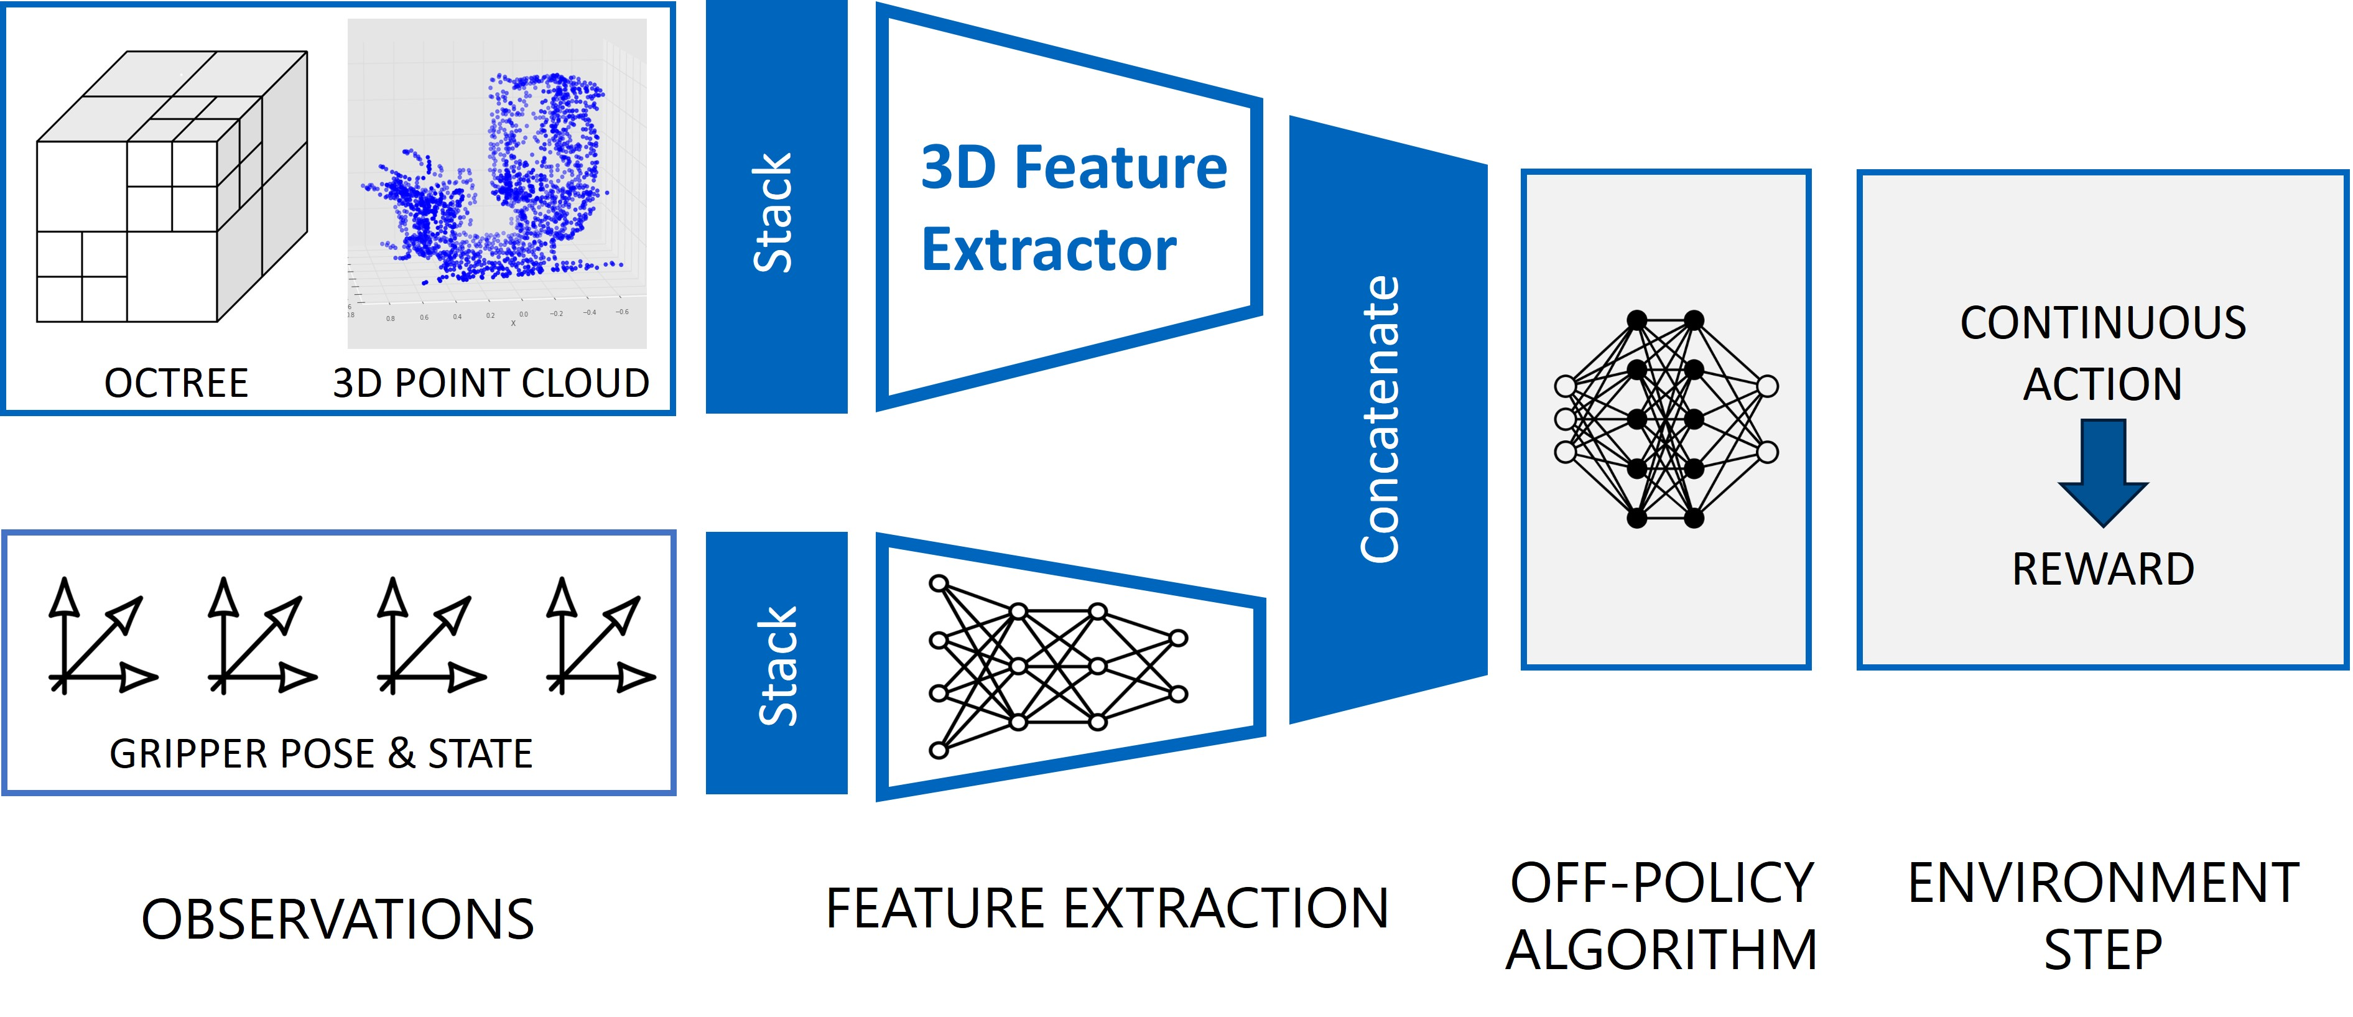
System Architecture - Main Pipeline

Slide 12
System Architecture - Reinforcement Learning Algorithm
Continuous action space: model-free learning
Sparse sampling due to expensive simulation step: off-policy algorithm
Current implementation supports actor-critic algorithms TD3, SAC, and TQC
Findings from base paper: TQC algorithm demonstrated best performance

Slide 13
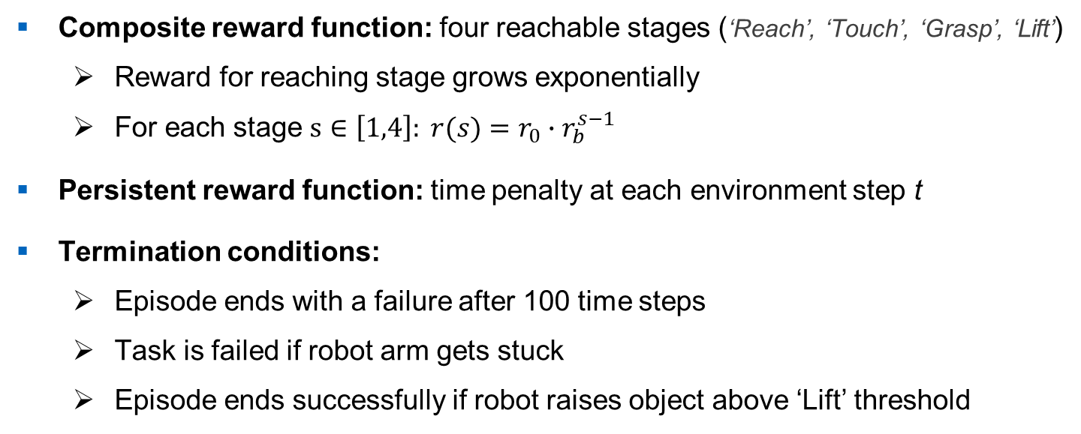
System Architecture - Curriculum
Composite reward function: four reachable stages (‘Reach’, ‘Touch’, ‘Grasp’, ‘Lift’)
Reward for reaching stage grows exponentially
For each stage $s∈\left[1,4\right]: r(s)=r_{0}∙r_{b}^{s−1}$
Persistent reward function: time penalty at each environment step t
Termination conditions:
Episode ends with a failure after 100 time steps
Task is failed if robot arm gets stuck
Episode ends successfully if robot raises object above ‘Lift’ threshold
Notes:
Formula:
$r_{0}$ is the base stage reward value
$r_{b}$ is the stage multiplier

Slide 14
Experiments and Results

Slide 15
Experiment Setup
Training Agents:
Train agent for 500k time steps
Run training process 3 times with different random seeds
Evaluate agent for 50 episodes every 25k time steps
Plot mean episode reward and success rate over time
Best Model Evaluation:
Evaluate best performing model under new random seed
Evaluation over 200 episodes
Notes:
Training is random and subjected to variance -> training 3 times helps to alleviate that

Slide 16
Reproduced Baseline Experiment
Training under theoretically identical conditions as base paper experiment:
TQC algorithm
O-CNN-based feature extractor
Standard curriculum:
Constant persistent time penalty
Dynamic lift height threshold
No single-object focus
Expected maximum success rate (from [1]): 33%

Slide 17
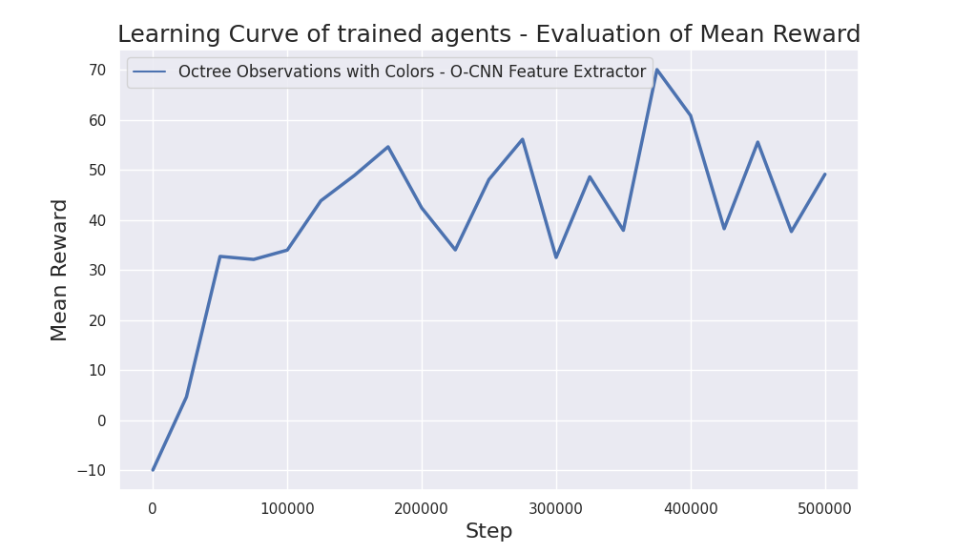
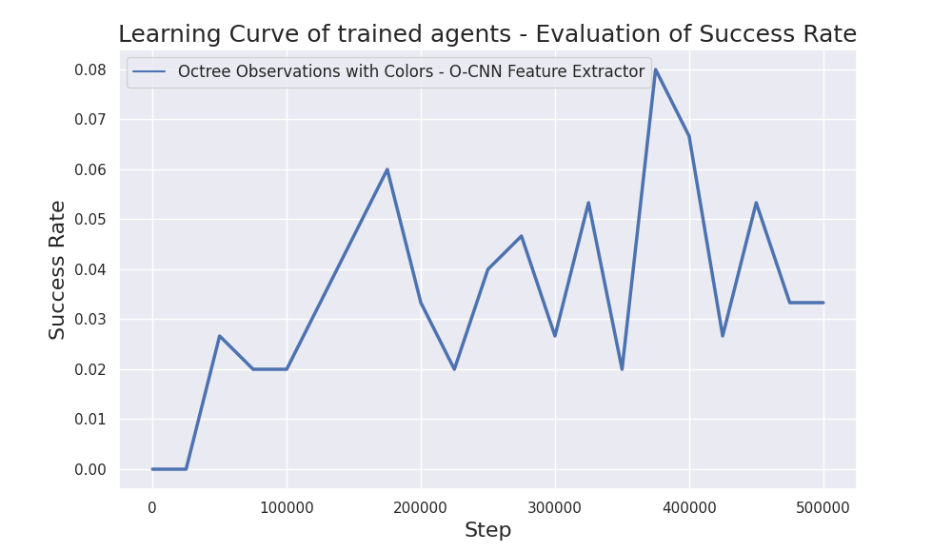
Reproduced Baseline Experiment

Slide 18
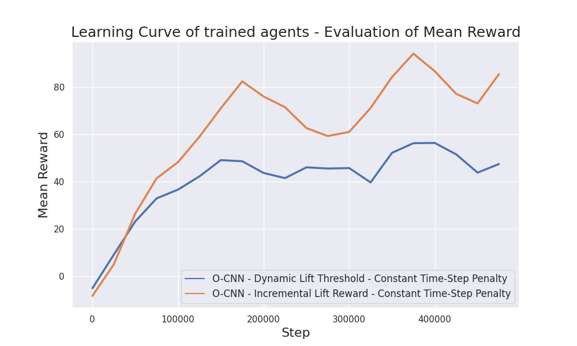
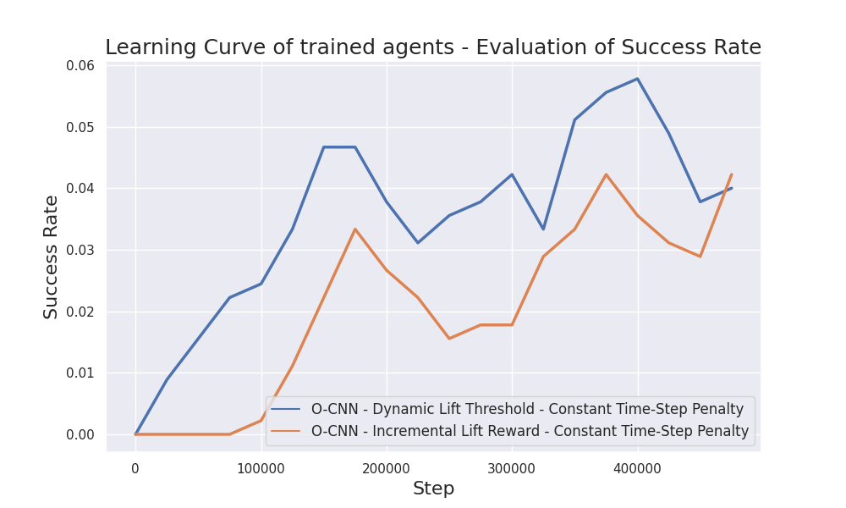
Experiments on Curriculum - “Lift” Stage Reward Function
Notes:
Base Case: dynamic (explain shortly) -> problem as it falsifies success rate when it is low
Incremental case: always have true height threshold & give portions of reward when reaching increments
Performance:
Mean reward not easily comparable as it is measured differently
Success rate: even though task is much harder in incremental case, almost same performance reached in the end -> superior

Slide 19
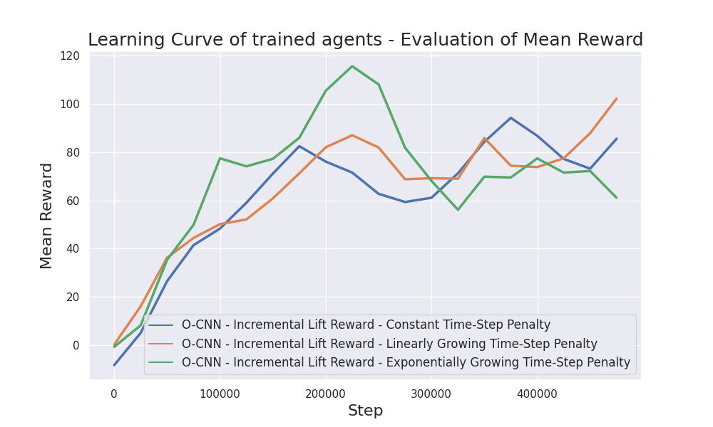
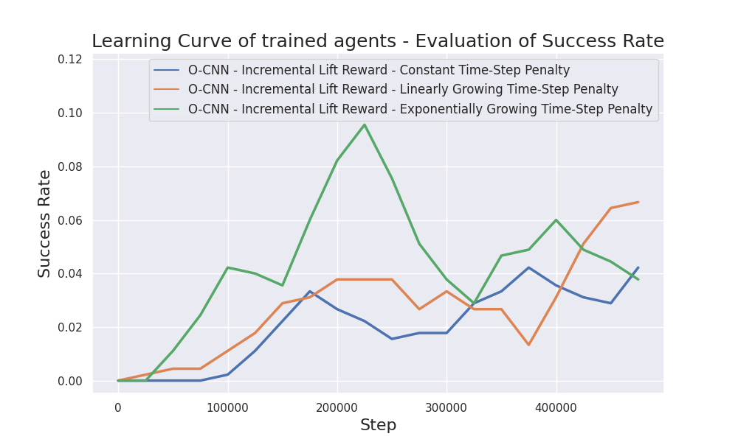
Experiments on Curriculum - Persistent Reward Penalty
Notes:
Base Case: penalty is constant (-0.1 per step)
Implement growing time-step penalty
Linear increases by 0.1 every 125k time steps / Exponential doubles every 125k time steps
Growing cases both perform better than constant case (higher success rate & reward from best model)
BUT: impossible to determine if constant or exponential case is superior
Should be very close for the first 250k steps, as conditions are identical
Exponential case performs significantly better
Shows that the variance is too high due to training instability
More Runs would be necessary to determine better approach with high confidence

Slide 20
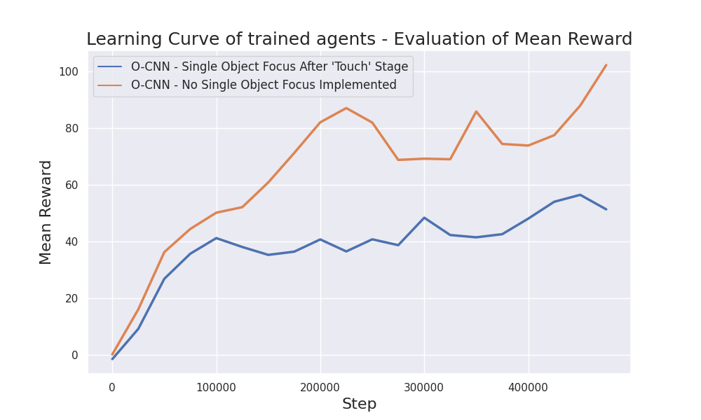
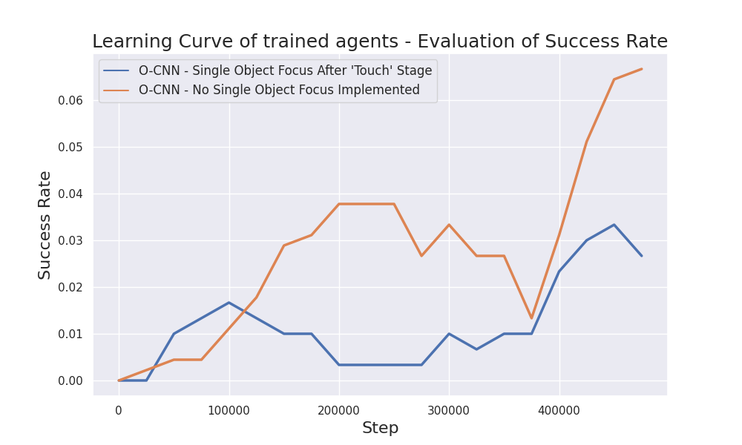
Experiments on Curriculum - Single-Object Focus
Notes:
Agent can only reach subsequent stages with same object as in previous stages
Idea: force agent to learn to focus on a single object & then grasp it (avoid random grasps)
Start from ‘Touch’ stage
Results:
Configuration with single-object focus performs significantly worse
Single-object focus reduces the occurrence frequency of later stages of the reward function
This doesn’t work well given the preexisting training instability

Slide 21
Experiments on Feature Extraction - PointNet-Based Encoder Model Choice
PointNet++ outperforms PointNet by only ~ 2% in instance classification accuracy
Forward pass of PointNet++ is much more computationally expensive
Feature Extractor Base | Forward Pass Duration (in ms)
 | Single Observation | Batch of 64 Observations
O-CNN (baseline) | 3.00 | 10.91
PointNet - using global features | 2.41 | 22.42
PointNet – using point-wise features | 2.81 | 33.28
PointNet++ - using global features | 135.48 | 580.52
Notes:
Mean forward pass duration was measured over 100 forward passes
Environment step duration is 400 ms → 135 ms could be problematic
580 ms for a batch forward pass → leads to significantly slower training (even though training duration is already a limitating factor)

Slide 22
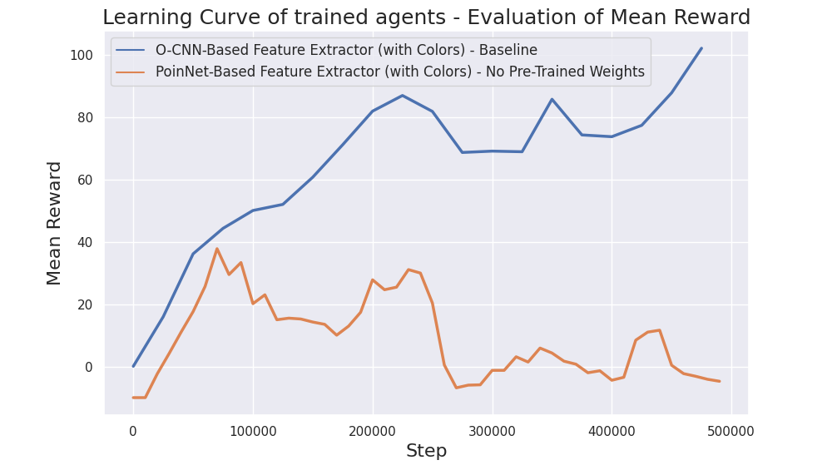
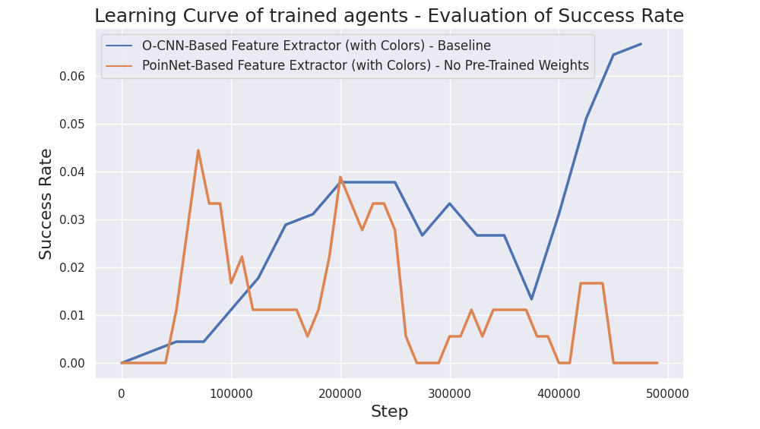
Experiments on Feature Extraction - Training Entire PointNet Encoder

Slide 23
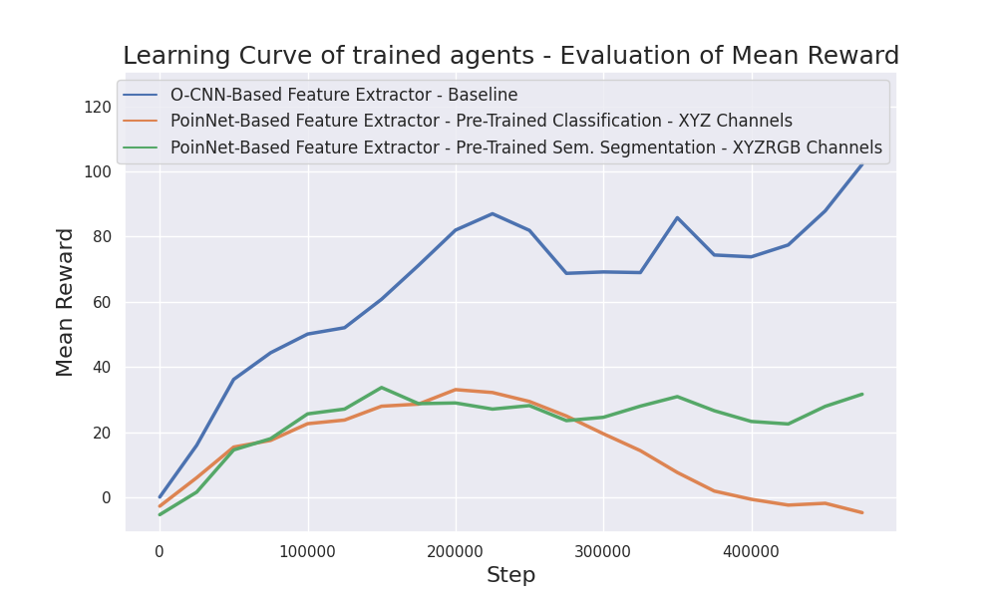
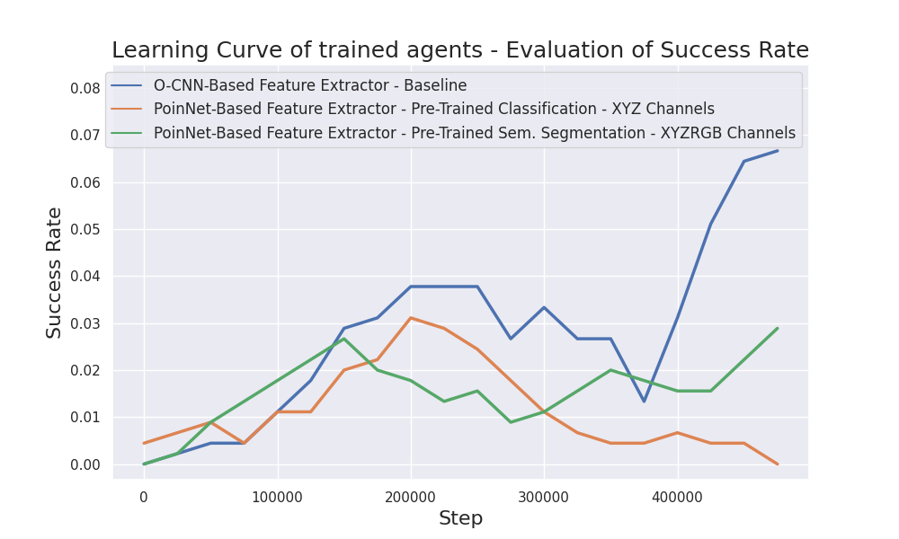
Experiments on Feature Extraction - PoinNet Encoder Backbone

Slide 24
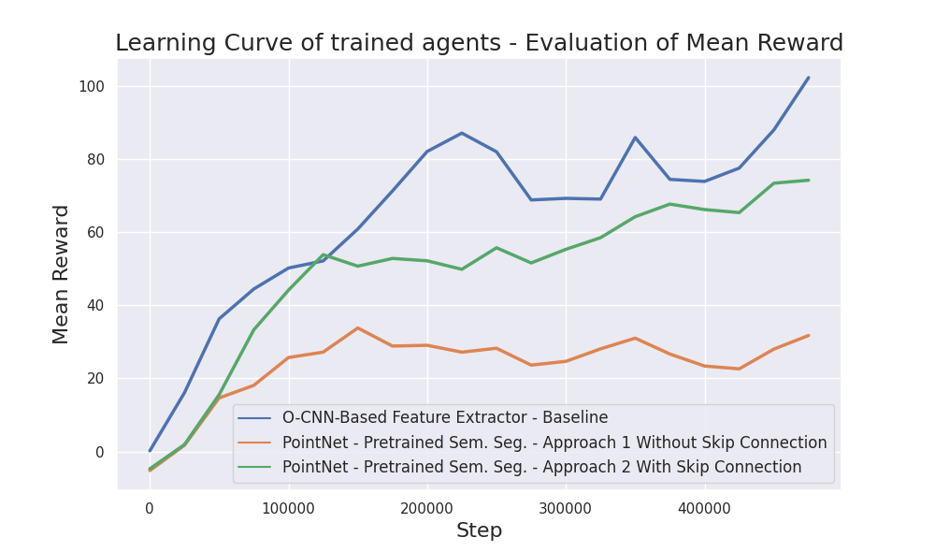
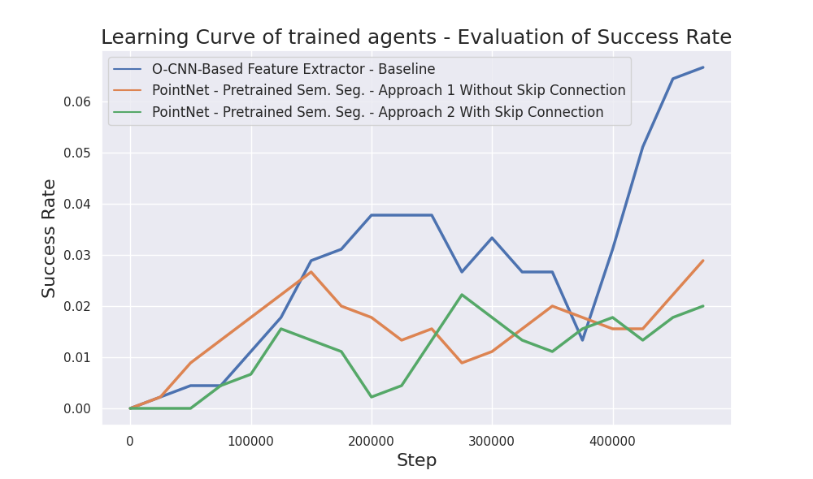
Experiments on Feature Extraction – PoinNet Learnable Section

Slide 25
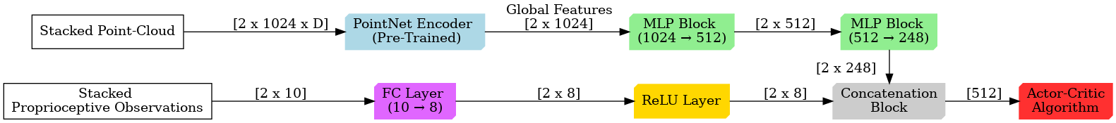
PoinNet Learnable Section - Architecture Approach 1

Slide 26
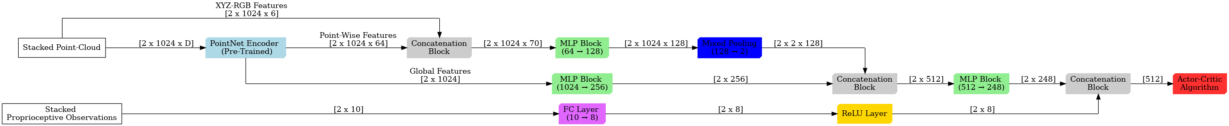
PoinNet Learnable Section - Architecture Approach 2

Slide 27
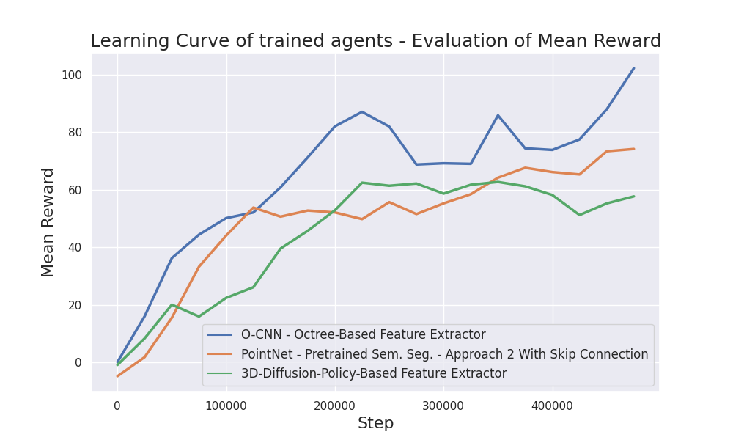
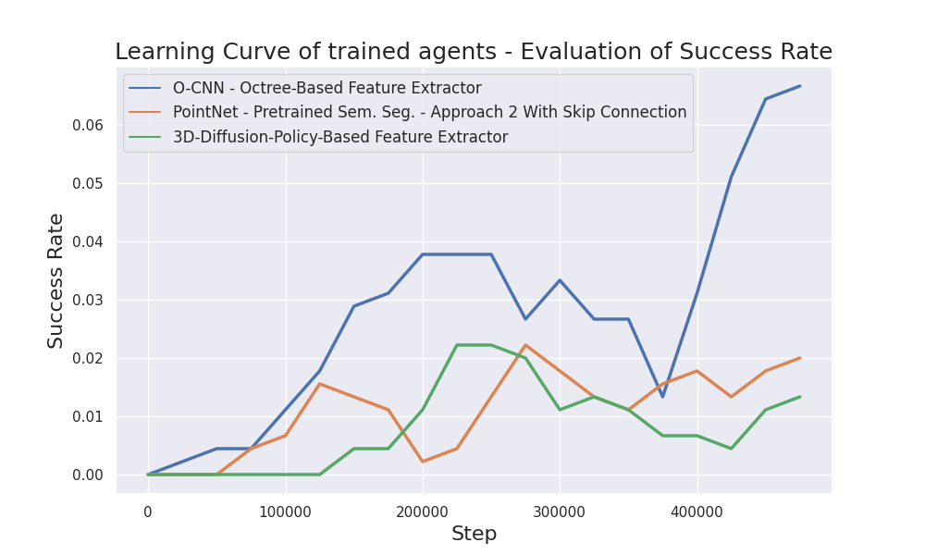
Experiments on Curriculum - 3D-Diffusion-Policy-Based Encoder
Notes:
Paper by Ze et al.

Slide 28
3D-Diffusion-Policy-Based Encoder - Architecture

Slide 29
Conclusion and Outlook

Slide 30
Conclusion
Performance increase from improved curriculum function:
Incremental ‘Lift’ stage reward function helps performance
Growing persistent reward function beneficial
More runs necessary to determine if linear or exponential increase is better
Single-object focus detrimental due to training instability in environment
Implementation of two point-cloud-based feature extractor approaches:
PointNet-based & 3D-Diffusion-Policy-based
Point-cloud-based approaches could not compete with octree-based approach

Slide 31
Outlook
Slow training and unfeasible parallelization limited achievable number of runs
Multiple runs due to low training stability from extensive domain randomization
→ Number of testable configurations severely limited
Future Works:
Determine optimal method for persistent reward penalty via additional runs
Perform experiments on point-cloud acquisition approaches
Implement success rate measurements for ‘Reach’, ‘Touch’, and ‘Grasp’ stages
Transfer code to lab environment setting to prepare for real-world transfer

Slide 32
Thank you for your attention

Slide 33
Sources
A. Orsula, S. Boegh, M. A. Olivares-Méndez, and C. Martínez. “Learning to Grasp on the Moon from 3D Octree Observations with Deep Reinforcement Learning.” In: 2022 IEEE/RSJ International Conference on Intelligent Robots and Systems (IROS) (2022), pp. 4112–4119.
J. Kuffner and S. LaValle. “RRT-connect: An efficient approach to single-query path planning.” In: Proceedings 2000 ICRA. Millennium Conference. IEEE International Conference on Robotics and Automation. Symposia Proceedings (Cat. No.00CH37065). Vol. 2. 2000, 995–1001 vol.2.
P. Beeson and B. Ames. “TRAC-IK: An open-source library for improved solving of generic inverse kinematics.” In: 2015 IEEE-RAS 15th International Conference on Humanoid Robots (Humanoids). 2015, pp. 928–935.
C. Qi, H. Su, K. Mo, and L. J. Guibas. “PointNet: Deep Learning on Point Sets for 3D Classification and Segmentation.” In: 2017 IEEE Conference on Computer Vision and Pattern Recognition (CVPR) (2016), pp. 77–85.
Y. Ze, G. Zhang, K. Zhang, C. Hu, M. Wang, and H. Xu. “3D Diffusion Policy.” In: ArXiv abs/2403.03954 (2024).

